Slide 1
Introduction to the course MCAC202: DATABASE SYSTEMS

Slide 2
Suggested Books
Database system concepts, Abraham Silberschartz, Henry F. Korth and S. Sudarshan, McGraw Hill.
Fundamentals of Database Systems, Ramez Elmasri and Shamkant B. Navathe, Pearson.
Database Management Systems, R. Ramakrishnan and J. Gehrke, McGraw Hill.
Databases and Transaction Processing-An application oriented approach, Philip Lewis, Arthur Berstein and Michael Kifer, Prentice Hall.

Slide 3
Evaluation Pattern
Continuous Internal Assessment (CIA): 30 Marks
Performance will be evaluated based on continuous evaluation.
There will be a minor test, assignments/ laboratory work.
CIA I : 15 Marks
Written Test
CIA II : 15 Marks
Written Test
Assignment, Laboratory Work, etc.
End of Semester Exam (EoSE): 70 marks
Passing Marks
40% in the End Semester Examination and 40% in the total of End Semester Examination & Internal Assessment

Slide 4
Syllabus
Entity Relationship model, Extended Entity Relationship model.
Unit 1
Unit 2
Unit 3
Unit 4
Unit 5
Unit 6
Unit 7
Basic Concepts: Data modeling for a database, abstraction and data integration, three level architecture of a DBMS.
Relational Model & Relational Data Manipulations: Relation, conversion of ER diagrams to relations, integrity constraints, relational algebra, relational domain & tuple calculus.
Structured Query Language: DDL, DML, Views, Embedded SQL.
Relational Database Design Concepts: Functional dependencies, determining keys, normalization-, lossless join and dependency preserving decomposition.
Transaction Management: ACID properties, Concurrency Control in databases, transaction recovery.
Introduction to NoSQL databases, XML databases.

Slide 5
Overview of Database Systems

Slide 6
What is Database System ?
Data:
Known facts that can be recorded and have an implicit meaning.
Database:
A collection of related data.
Database Management System (DBMS):
Software for creating, storing, maintaining, and accessing database files
Makes using databases more efficient
There are many databases available like MySQL, Sybase, Oracle, MongoDB, Informix, PostgreSQL, SQL Server, etc.
Database System:
The DBMS software together with the data itself. Sometimes, the applications are also included.

Slide 7
What is the need of DBMS?
When dealing with huge amount of data, there are two things that require optimization:
Data storage: Efficient storage, no redundancy.
Data retrieval: Retrieve the data quickly when needed
Why Use a DBMS ?
Large amount of data (Giga’s, Tera’s) drives many business processes
Data is very structured
Persistent and valuable data
Performance requirements
Concurrent and restricted access to the data

Slide 8
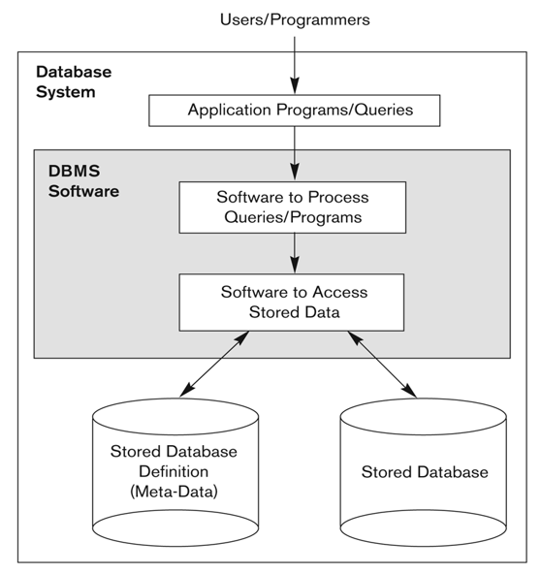
Simplified database system environment
A simplified database system environment
Image Source: Fundamentals of Database Systems, Ramez Elmasri and S. B. Nabathe

Slide 9
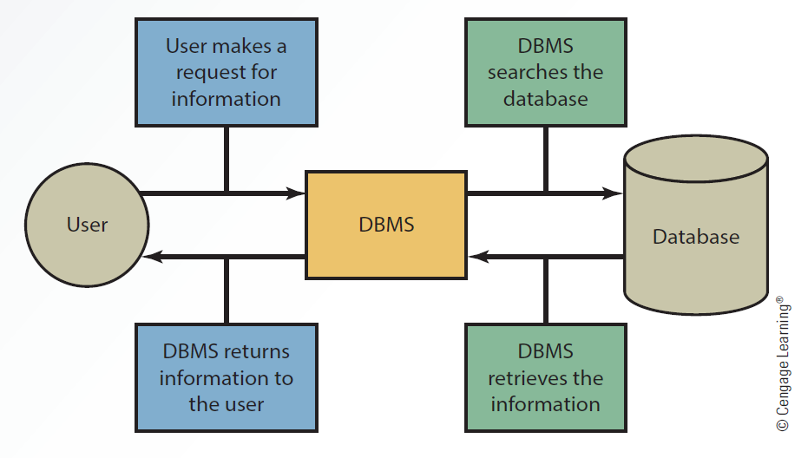
Interaction between the User, DBMS and Database

Slide 10
Applications
Telecom
Calls made, network usage, customer details etc.
Industry
Where it is a manufacturing unit, to keep the records of ins and outs.
Banking System
For storing customer info, tracking day to day credit and debit transactions, generating bank statements etc.
Sales
To store customer information, production information and invoice details.
Airlines
Reservation information along with flight schedule is stored in database.
Education sector
To store and retrieve the data regarding student details, staff details, course details, exam details, payroll data, attendance details, fees details etc.
Online shopping
To store the product information, your addresses and preferences, credit details and provide you the relevant list of products based on your query.

Slide 11
Why not use simple file to store the data ?
Drawbacks of File system
Data redundancy
Duplication of data
Requires more storage than needed.
Higher storage costs and poor access time.
Data inconsistency:
Data redundancy leads to data inconsistency
Data Isolation
Property that determines when and how changes made by one operation become visible to other concurrent users and systems. Difficult to achieve in file processing system.
Dependency on application programs: Changing files would lead to change in application programs.

Slide 12
Why not use simple file to store the data ?
Drawbacks of File system
Atomicity issues: “All or nothing”
For example: Ram transfers 1000 INR to Krishna account.
Debit 1000 rupees from Ram account
Credit 1000 rupees to Krishna account
What if the system fails after first operation ?
In such case the rollback of operation should occur to maintain the atomicity of transaction.
It is difficult to achieve atomicity in file processing systems.
Data Security:
Data should be secured from unauthorized access.
For example a student should not be able to access grades.
Such kind of security constraints are difficult to apply in file processing systems.

Slide 13
Advantage of DBMS over file system
Data Independence
Application programs should not, ideally, be exposed to details of data representation and storage.
No redundant data:
Data normalization removes the data redundancy.
Saves storage and improves access time.
Data Consistency
Data Integrity and Security
data is always accessed through the DBMS, the DBMS can enforce integrity constraints.
Each user has a different set of access thus data is secured.

Slide 14
Advantage of DBMS over file system
Privacy: Limited access means privacy of data.
Easy access to data – Data is easily accessible with fast response times.
Concurrent Access
Easy recovery:
Keeps the backup of data.
Easy to recover data in case of a failure.
Flexible: Database systems are more flexible than file processing systems.

Slide 15
Disadvantages of DBMS:
DBMS implementation cost is high compared to the file system
Complexity: Database systems are complex to understand
Performance: Database systems are generic, making them suitable for various applications affect their performance for some applications.

Slide 16
When not to use a DBMS
Main inhibitors (costs) of using a DBMS:
High initial investment and possible need for additional hardware.
Overhead for providing generality, security, concurrency control, recovery, and integrity functions.
When a DBMS may be unnecessary:
If the database and applications are simple, well defined, and not expected to change.
If there are stringent real-time requirements that may not be met because of DBMS overhead.
If access to data by multiple users is not required.
When no DBMS may suffice:
If the database system is not able to handle the complexity of data because of modeling limitations
If the database users need special operations not supported by the DBMS.

Slide 17
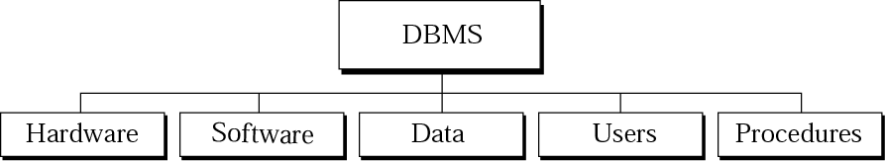
DBMS components
Hardware
Physical computer system that allows physical access to data.
Software
Actual program that allows users to access, maintain, and update physical data.
Data
Stored physically on the storage devices
Users
database implementors, who build DBMS software,
End users - Normal user and DBA (Database Administrator)
Application programs, Application programmers
Procedures
a set of rules that should be clearly defined and followed by the users.

Slide 18
Database Administrator Responsibilities
Design of the Conceptual and Physical Schemas
Security and Authorization
Data Availability and Recovery from Failures.

Slide 19
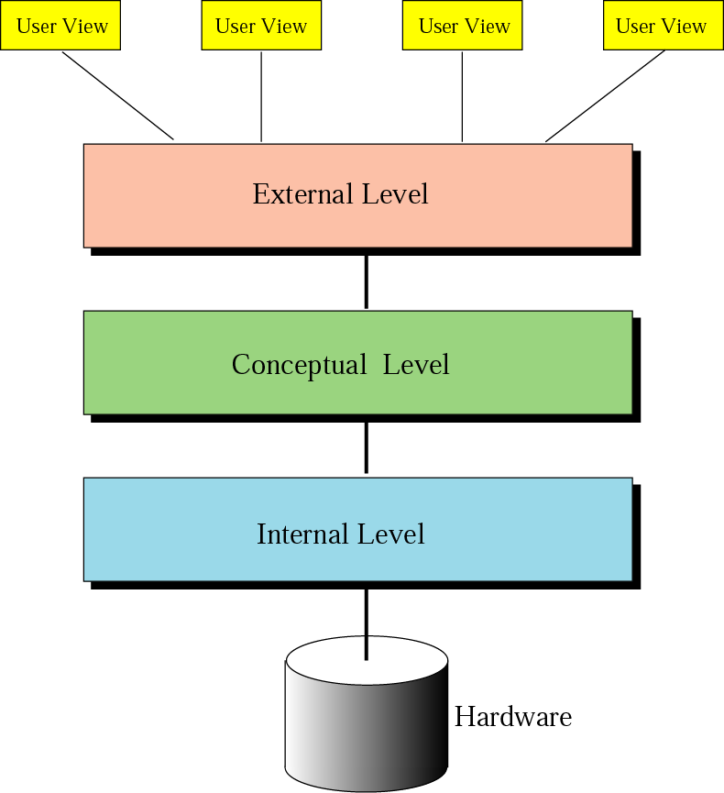
Architecture
Internal level
Determines where data are actually stored on the storage device.
Low-level access method
Conceptual level
Defines the logical view of the data
The main functions of DBMS are in this level.
External level
Interacts directly with the user.
Change the data coming from the conceptual level to a format and view that are familiar to the users.

Slide 20
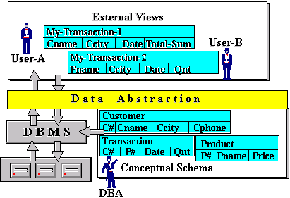
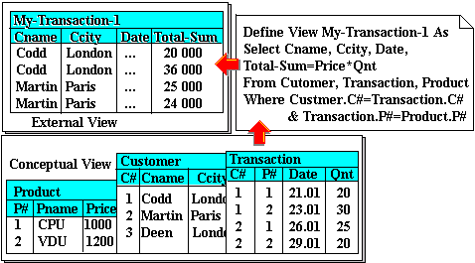
Example
http://coronet.iicm.edu/Dbase1/scripts/rdbh12.htm

Slide 21
Database Models
Data models define how the logical structure of a database is modeled.
Collection of high-level data description constructs that hide many low-level storage details
Defines the logical design of data.
Describes the relationships between different parts of data.
Different models
Hierarchical model
Network model
Relational model
The object-oriented model

Slide 22
Evolution of major Database Models
Image Source: Database Systems 6e / Rob & Coronel

Slide 23
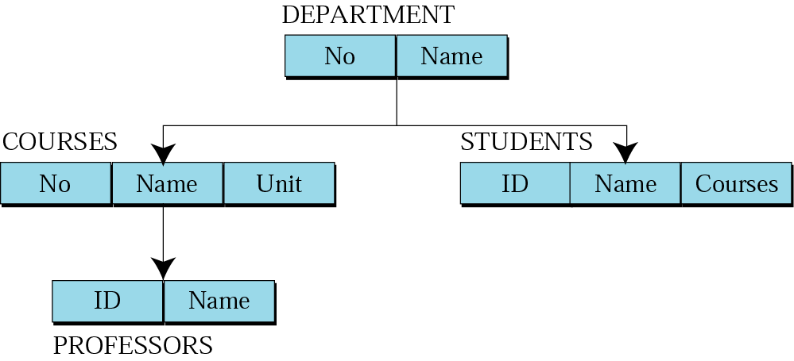
Hierarchical model
Data are organized as an upside down tree.
Each entity has only one parent but can have several children.

Slide 24
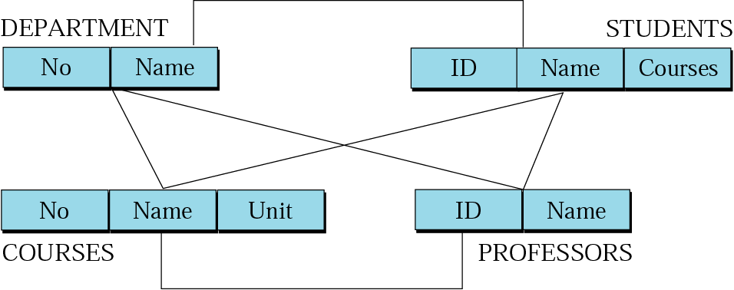
Network model
The entities are organized in a graph.
Some entities can be accessed through several paths.

Slide 25
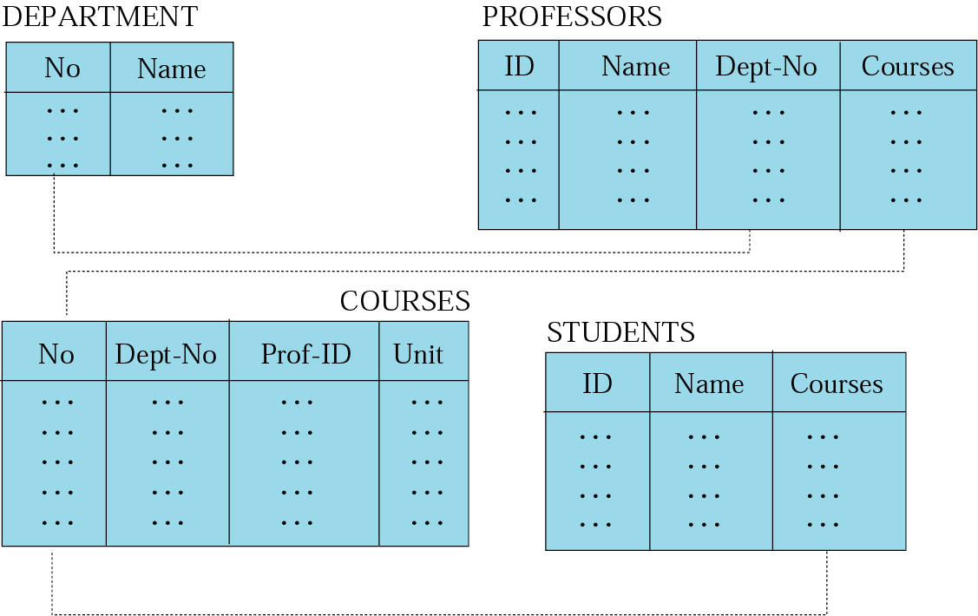
Relational model
Data are organized in two-dimensional tables called relations.
The tables are related to each other.

Slide 26
Relational model
RDBMS (Relational Database Management System)
external view
The data are represented as a set of relations.
A relation is a two-dimensional table.
This doesn’t mean that data are stored as tables; the physical storage of the data is independent of the way the data are logically organized.

Slide 27
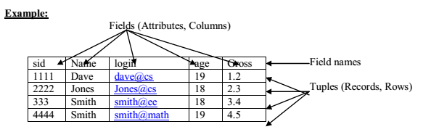
Relation
Name – each relation in a relational database should have a name that is unique among other relations.
Attribute – each column in a relation.
The degree of the relation – the total number of attributes for a relation.
Tuple – each row in a relation.
The cardinality of the relation – the total number of rows in a relation.
Students

Slide 28
Schema
The overall design of the database is called the database schema.
In the relational model, the schema for a relation specifies
Relation name
The name of each field (or attribute or column)
The type of each field.
Example: Student information in a university
Schema: Students( sid: string, name: string, login: string, age: integer, gpa: real)

Slide 29
Levels of Abstraction in a DBMS
Database systems have several schemas, partitioned according to the levels of abstraction.
Physical schema:
The physical schema describes the database design at the physical level
Conceptual schema
The logical schema describes the database design at the logical level.
External schema
A database may also have several schemas at the view level, sometimes called subschemas, that describe different views of the database.
A data definition language (DDL) is used to define the external and conceptual schemas.
Image Source: https://www.javatpoint.com/dbms-three-schema-architecture

Slide 30
Data Independence
Change the Database schema at one level of a database system without requiring to change the schema at the next higher level.
Physical Data Independence: With Physical independence, you can easily change the physical storage structures or devices with no effect on the conceptual schema.
Any change done would be absorbed by the mapping between the conceptual and internal levels
Examples of internal level changes: Due to Physical independence, any these changes will not affect the conceptual layer.
Using a new storage device like Hard Drive or Magnetic Tapes
Modifying the file organization technique in the Database
Switching to different data structures.
Changing the access method, Modifying indexes.
Changes to compression techniques or hashing algorithms.
Change of Location of Database from say C drive to D Drive

Slide 31
Data Independence
Logical Data Independence: Logical Data Independence is the ability to change the conceptual scheme without changing External views or External programs.
Any change made will be absorbed by the mapping between external and conceptual level.
Examples of Conceptual level changes: Due to Logical independence, any of these changes will not affect the external layer.
- Add/Modify/Delete a new attribute, entity or relationship is possible without a rewrite of existing application programs
- Merging two records into one, - Breaking an existing record into two or more records

Slide 32
Operations on relations
In a relational database, we can define several operations to create new relations out of the existing ones.
Basic operations:
Insert
Delete
Update
Select
Project
Join
Union
Intersection
Difference

Slide 33
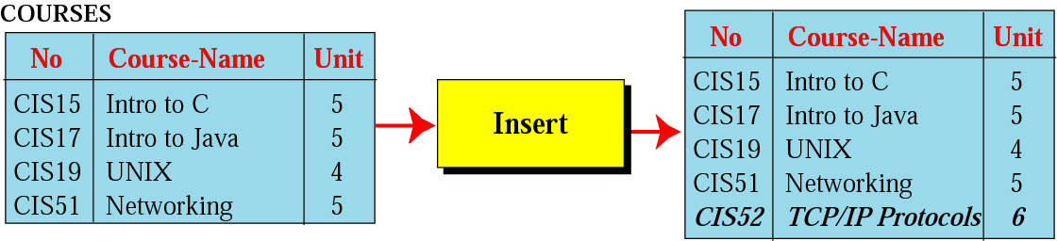
Insert operation
Insert a new tuple into the relation.

Slide 34
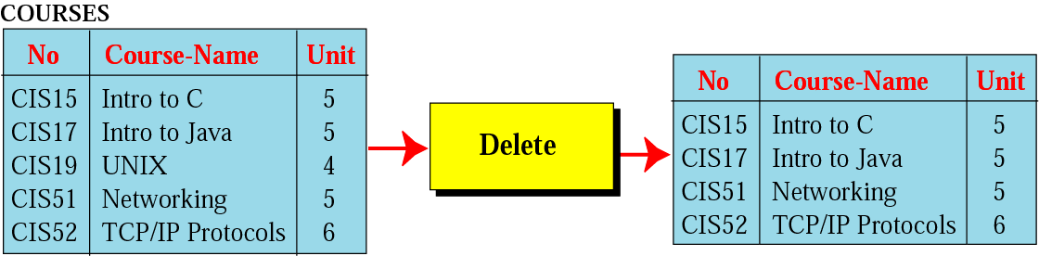
Delete operation
Delete a tuple defined by a criterion from the relation.

Slide 35
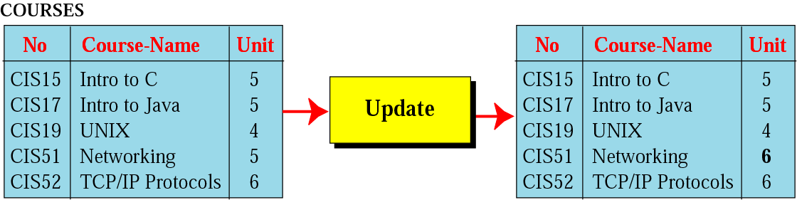
Update operation
Changes the value of some attributes of a tuple.

Slide 36
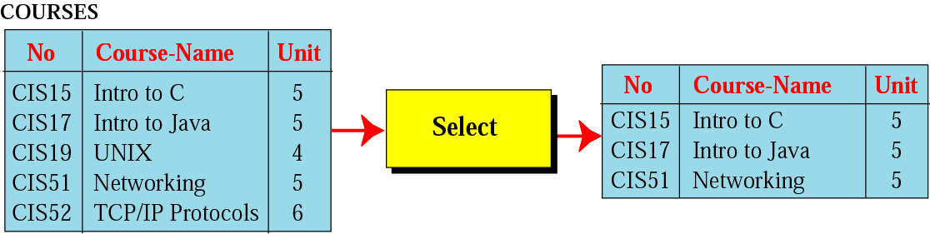
Select operation
It is applied to one single relation and creates another relation.
The tuples in the resulting relation are a subset of the tuples in the original relation.
Use some criteria to select

Slide 37
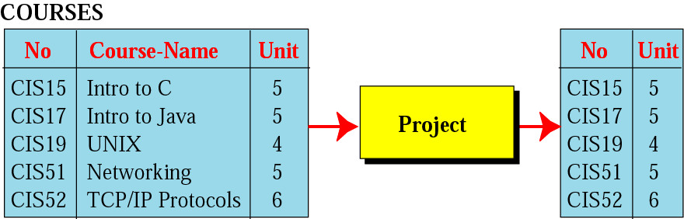
Project operation
It is applied to one single relation and creates another relation.
The attributes in the resulting relation are a subset of the attributes in the original relation.

Slide 38
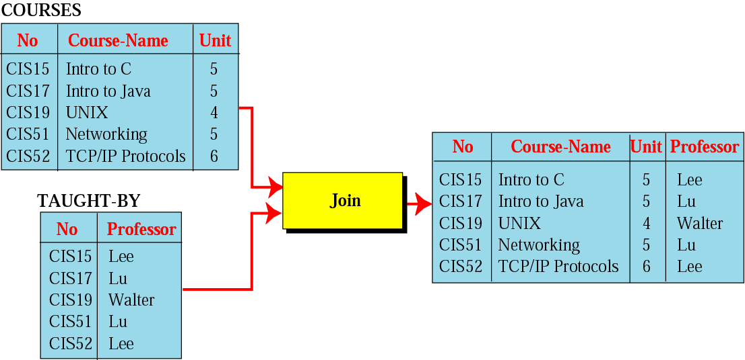
Join operation
A binary operation.
Combines two relations based on common attributes.

Slide 39
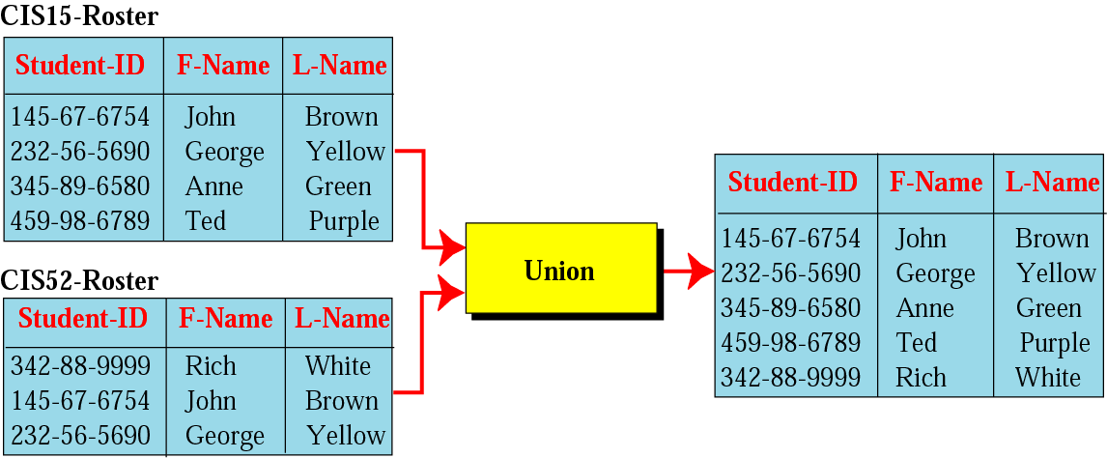
Union operation
A binary operation.
Creates a new relation in which each tuple is either in the first relation, in the second, or in both.
The two relations must have the same attributes.

Slide 40
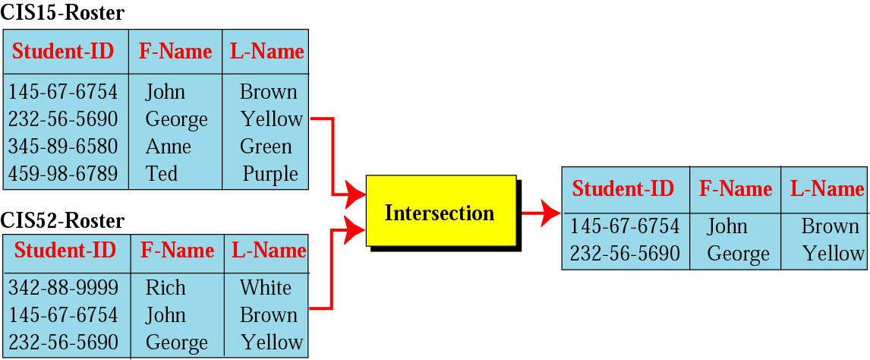
Intersection operation
A binary operation.
Creates a new relation in which each tuple is a member in both relations.
The two relations must have the same attributes.

Slide 41
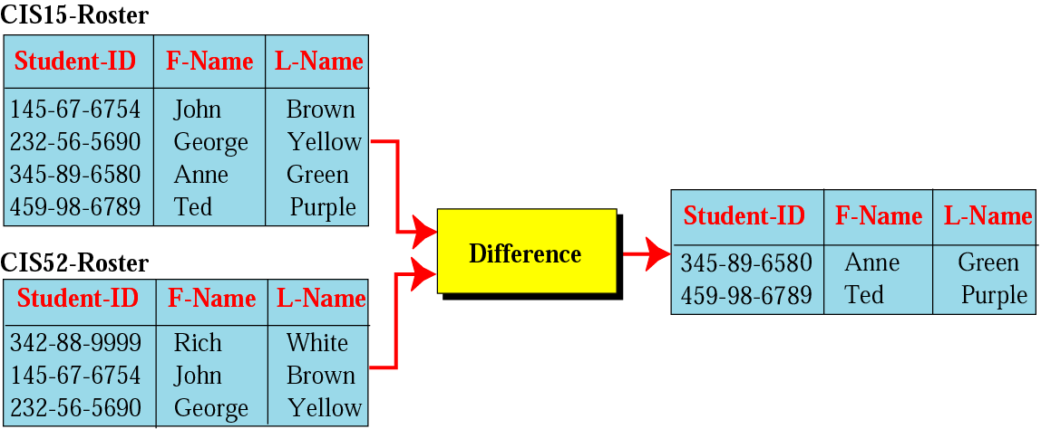
Difference operation
A binary operation.
Creates a new relation in which each tuple is in the first relation but not the second.
The two relations must have the same attributes.

Slide 42
Queries in a DBMS
Here are some questions a user might ask from a university database system.
What is the name of the student with student ID 1234567
What is the average salary of professors who teach course CS5647
How many students are enrolled in CS5647
What fraction of students in CS564 received a grade better than B7
Is any student with a CPA less than 3.0 enrolled in CS5647
Such questions involving the data stored in a DBMS are called queries.
A DBMS provides a specialized language, called the query language, in which queries can be posed. Eg: SQL (structured query language)
A DBMS enables users to create, modify, and query data through a data manipulation language (DML).

Slide 43
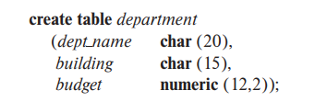

Database Languages
Data-definition language (DDL)
We specify a database schema by a set of definitions expressed by a special language called a data-definition language (DDL).
DDL provides facilities to specify various constraints
Domain Constraints
Referential Integrity
Authorization
Data-manipulation language (DML)
Enables users to access or manipulate data as organized by the appropriate data model.

Slide 44
Transaction Management
Scenario 1: Multiple customers accessing the available seat information in Airlines and trying to book.
Scenario 2:
Two transactions
T₁: Read(x) T₂: Read(x)
x ←x+100 x ← x-100
Write(x) Write(x)
Commit Commit
Possible execution sequences:
T₁: Read(x) T₁: Read(x) 500
T₁: x ← x+100 T₂: Read(x) 500
T₁: Write(x) T₁: x ← x+100 600
T₁: Commit T₁: Write(x) 600
T₂: Read(x) T₂: x ← x-100 400
T₂: x ← x-100 T₂: Write(x) 400
T₂: Write(x) T₁: Commit 600
T₂: Commit T₂: Commit 400

Slide 45
Transaction Management
A transaction is a single logical unit of work which accesses and possibly modifies the contents of a database.
Transactions access data using read and write operations.
In order to maintain consistency in a database, before and after the transaction, certain properties are followed. These are called ACID properties.

Slide 46
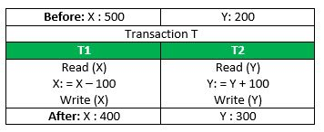
Principles of Transaction
ATOMICITY
all or nothing
CONSISTENCY
no violation of integrity constraints
ISOLATION
concurrent changes invisible ⇒ serializable
DURABILITY
committed updates persist
Consider the following transaction T consisting of T1 and T2: Transfer of 100 from account X to account Y.

Slide 47
Principles of Transaction
ATOMICITY
all or nothing
If the transaction fails after completion of T1 but before completion of T2
This results in an inconsistent database state.
Therefore, the transaction must be executed in entirety in order to ensure correctness of database state.
Consider the following transaction T consisting of T1 and T2: Transfer of 100 from account X to account Y.

Slide 48
Principles of Transaction
CONSISTENCY
no violation of integrity constraints
Inconsistency occurs, if the transaction fails after completion of T1 but before completion of T2
This means that integrity constraints must be maintained so that the database is consistent before and after the transaction.
The total amount before and after the transaction must be maintained.
Total before T occurs = 500 + 200 = 700.
Total after T occurs = 400 + 300 = 700.
Consider the following transaction T consisting of T1 and T2: Transfer of 100 from account X to account Y.

Slide 49
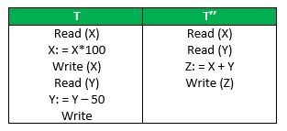
Principles of Transaction
ISOLATION
concurrent changes invisible ⇒ serializable
Isolation ensures that concurrent execution of transactions leaves the database in the same state that would have been obtained if the transactions were executed sequentially.
Example: a teller looking up a balance must be isolated from a concurrent transaction involving a withdrawal from the same account.
Let X= 500, Y = 500. Consider two transactions T and T”.
Suppose T has been executed till Read (Y) and then T’’ starts.
T’’: (X+Y = 50, 000+500=50, 500)
T: (X+Y = 50, 000 + 450 = 50, 450).

Slide 50
Principles of Transaction
DURABILITY
committed updates persist
This property ensures that once the transaction has completed execution, the updates and modifications to the database are stored in and written to disk and they persist even if a system failure occurs.

Slide 51
References
Adhsakkdi Y Raghuram Krishnan and Johannes Gehrke, Database Management Systems, 3/e, TMH, 2007.
Referred various online sources for examples and images.

